Slide 1
Real.PPT FREE TEMPLATE #103
https://pptfree.wonjc.com

Slide 2

A blessing for you.
Never think hard about the PAST, It brings tears. Don’t think more about the FUTURE, It brings fears. Live this moment with a smile, It brings cheers.

Slide 3
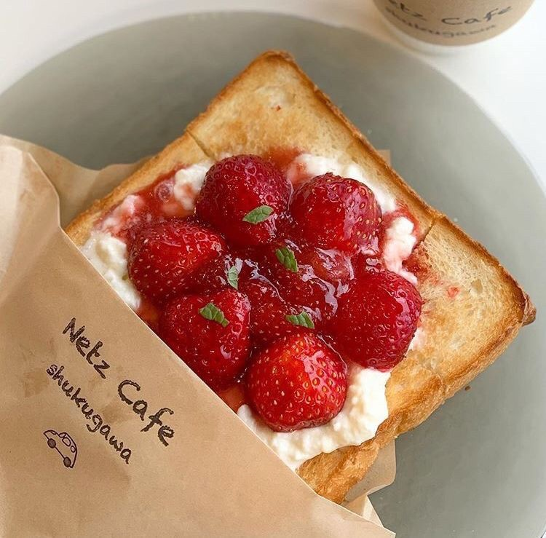
It’s trusting the stream
Remember, how you live your life is far more important than how much you earn. Life soon ends. What matters is whether you enjoyed life and lived meaningfully.

Slide 4



Think of what a precious privilege it is to be alive- to breathe, to think, to enjoy, and to chase the things you love.
We must keep putting one foot in front of the other even when we hurt, for we will never know what is waiting for us just around the bend
Sometimes there is sadness in our journey, but there is also lots of beauty.
It’s trusting the process.
a.
b.
c.

Slide 5

Listen to your dreams. Follow your heart
Everything you want is coming. Relax and let the universe pick the timing and the way. You just need to trust that what you want is coming and watch how fast it comes.
Do what you love. Enjoy life. And expect miracles.

Slide 6
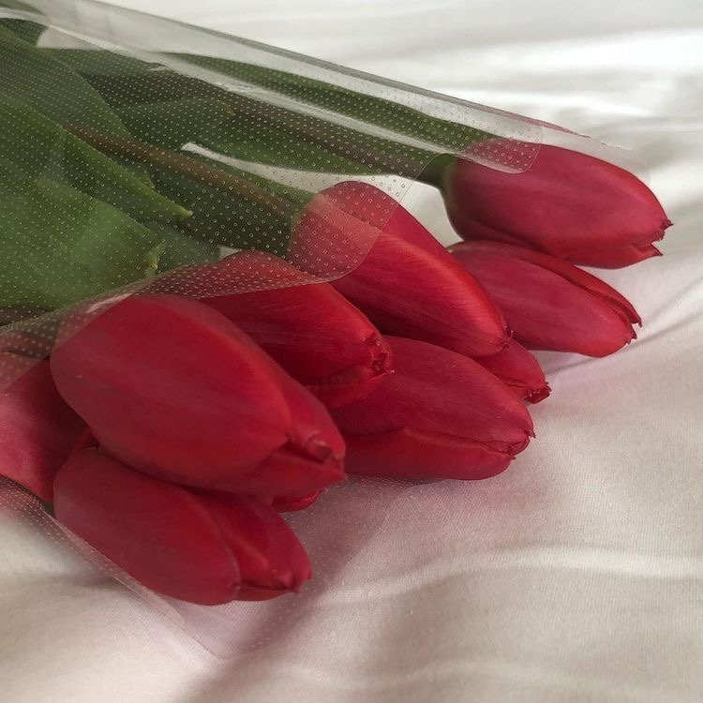
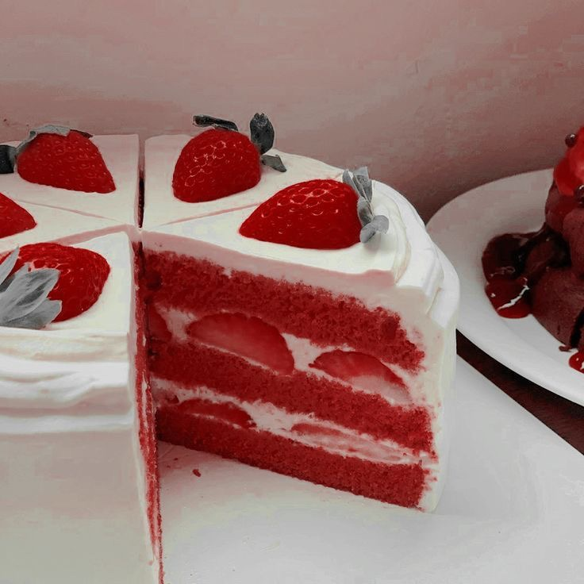
Grace and peace to your this day.
Be honest when in trouble and simple when in wealth. Be polite when in authority and be silent when in anger.
May you be free of all burdens, and know that you are completely cared for.

Slide 7

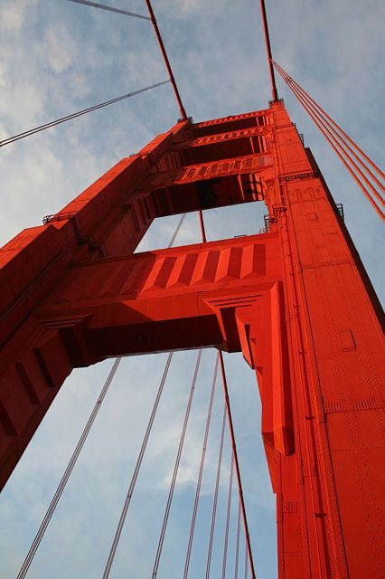

May you be free of all burdens, and know that you are completely cared for.
Be thankful for everybody in your life. Good or bad past or present they all made you the person that you are today.

Slide 8
THANK YOU ☺

